Slide 1

GULP
FICTION
Character
Notebook
‘Macbeth’
By
William Shakespeare
Watch the GULP FICTION explanation videos for each quote. Then, as you watch, pause and take notes in this pack.
gulpfiction.co.uk

Slide 2
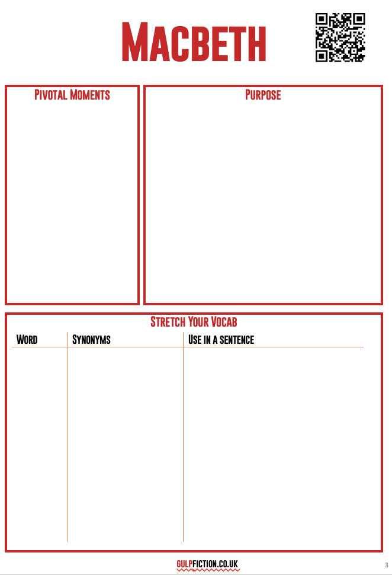
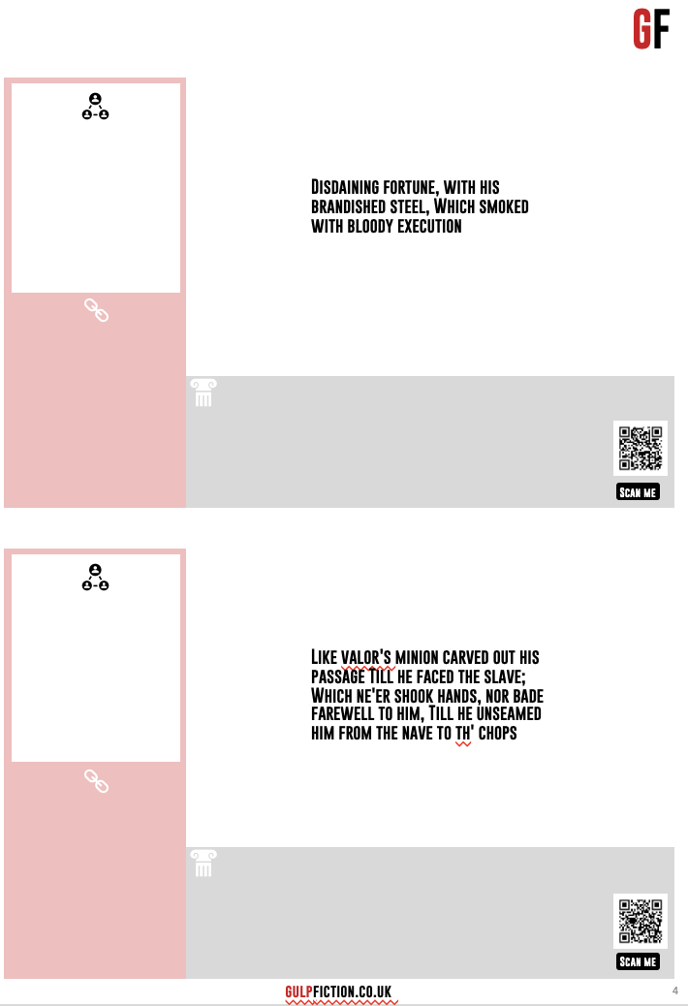
How to use the notebook
Scan the QR to find more information on pivotal moments, the character’s purpose and stretch vocabulary
Use Google to look up any familiar words and put them in a sentence about the character
A summary of the quote. Who says it and what’s going on
Other quotes that link to the one you are analysing
Any historical context that might be useful
Language analysis goes around the quote
Scan the QR to go to the analysis
Remember to have a go at getting all your ideas and knowledge down before you go to the website or videos!

Slide 3
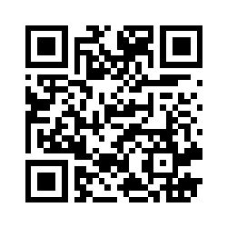
Macbeth
Pivotal Moments
Purpose
Stretch Your Vocab
Word
Synonyms
Use in a sentence
gulpfiction.co.uk

Slide 4



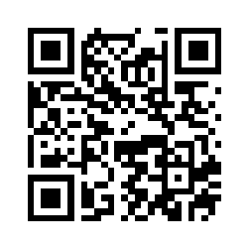
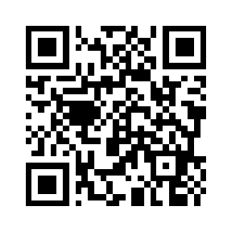
GF
“Disdaining fortune, with his brandished steel, Which smoked with bloody execution”
Scan me
”like valor's minion carved out his passage Till he faced the slave; Which ne'er shook hands, nor bade farewell to him, Till he unseamed him from the nave to th' chops”
Scan me
gulpfiction.co.uk

Slide 5
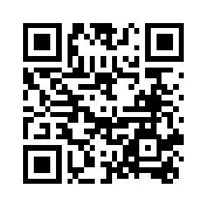
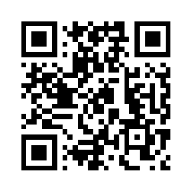
GF
“False face must hide what the false heart doth know.”
Scan me
“Nothing, To prick the sides of my intent, but only vaulting ambition"
Scan me
gulpfiction.co.uk

Slide 6
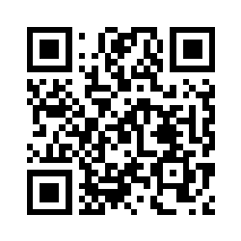
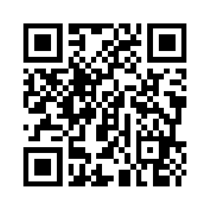
GF
“Is this a dagger which I see before me”
Scan me
“Will all great Neptune’s ocean wash this blood
Clean from my hand?"
Scan me
gulpfiction.co.uk

Slide 7
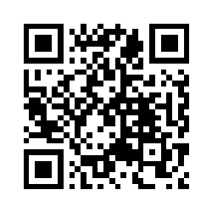
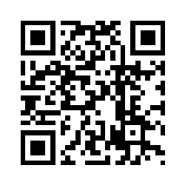
GF
"I am in blood/Stepped in so far that, should I wade no more/Returning were as tedious as go o’er"
Scan me
"Life’s but a walking shadow"
Scan me
gulpfiction.co.uk

Slide 8
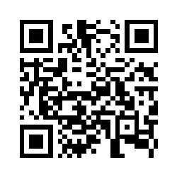
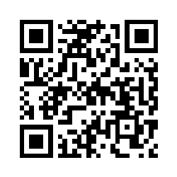
GF
“Turn, hellhound, turn!”
Scan me
“…this dead butcher and his fiendlike queen”
Scan me
gulpfiction.co.uk

Slide 9
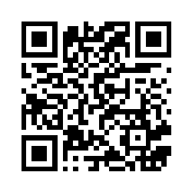
Lady Macbeth
Pivotal Moments
Purpose
Stretch Your Vocab
Word
Synonyms
Use in a sentence
gulpfiction.co.uk

Slide 10
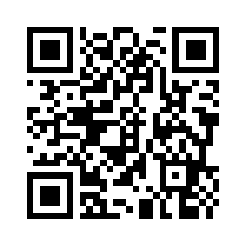
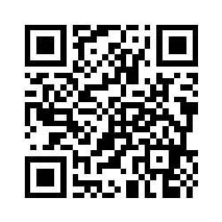
GF
"The raven himself is hoarse/That croaks the fatal entrance of Duncan/Under my battlements”"
Scan me
“Yet do I fear thy nature;
It is too full o’ the milk of human kindness.”
Scan me
gulpfiction.co.uk

Slide 11
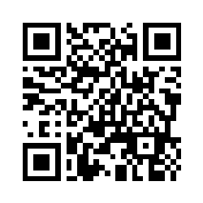
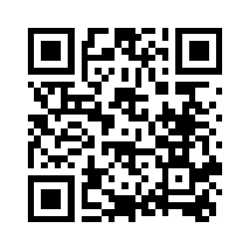
GF
“Come you spirits, That tend on mortal thoughts, unsex me here.”
Scan me
“Look like th’ innocent flower,/But be the serpent under ‘t.”
Scan me
gulpfiction.co.uk

Slide 12
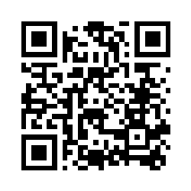
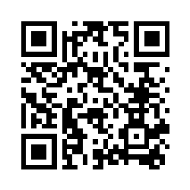
GF
"Have plucked my nipple from his boneless gums/And dashed the brains out"
Scan me
"All the perfumes of Arabia will not sweeten this little hand.”
Scan me
gulpfiction.co.uk

Slide 13
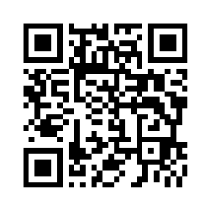
The Witches
Pivotal Moments
Purpose
Stretch Your Vocab
Word
Synonyms
Use in a sentence
gulpfiction.co.uk

Slide 14
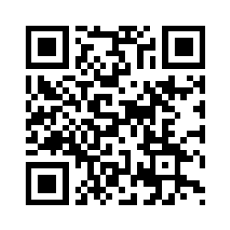
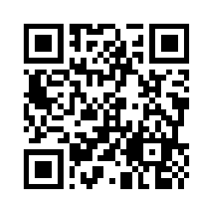
GF
“Fair is foul, and foul is fair.”
Scan me
When shall we three meet again?
In thunder, lightning, or in rain?
Scan me
gulpfiction.co.uk

Slide 15
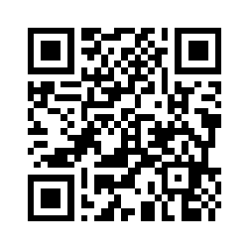
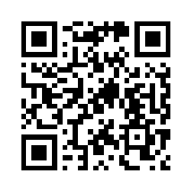
GF
'Aroint thee, witch' the rump-fed ronyon cries.
Her husband's to Aleppo gone, master o' the Tiger.
But in a sieve, I'll thither sail,
And, like a rat without a tail,
I'll do, I'll do, and I'll do.
Scan me
"All hail, Macbeth!
Hail to thee, thane of Glamis!
All hail, Macbeth! Hail to thee, thane of Cawdor!
All hail, Macbeth, that shalt be king hereafter!"
Scan me
gulpfiction.co.uk

Slide 16
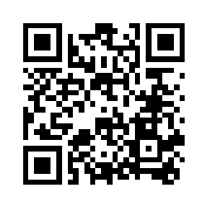
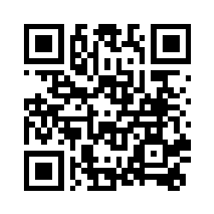
GF
"Fillet of a fenny snake,
In the cauldron boil and bake;
Eye of newt and toe of frog,
Wool of bat and tongue of dog,
Adder's fork and blind-worm's sting,
Lizard's leg and owlet's wing,
For a charm of powerful trouble,
Like a hell-broth boil and bubble."
Scan me
“By the pricking of my thumbs,
Something wicked this way comes.”
Scan me
gulpfiction.co.uk

Slide 17
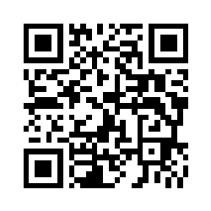
Banquo
Pivotal Moments
Purpose
Stretch Your Vocab
Word
Synonyms
Use in a sentence
gulpfiction.co.uk

Slide 18
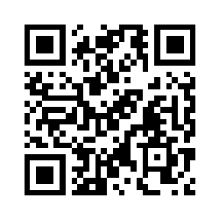
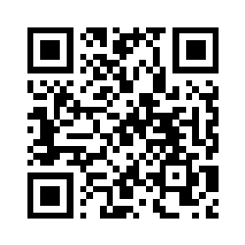
GF
"Thou shalt get kings, though thou be none"
Scan me
“And oftentimes, to win us to our harm,
The instruments of darkness tell us truths”
Scan me
gulpfiction.co.uk

Slide 19
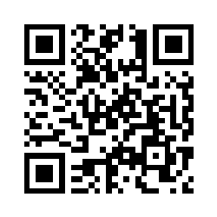
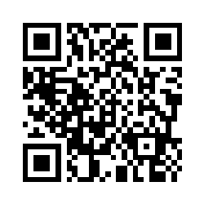
GF
“Thou has it no king, Cawdor, Glamis, all.
As the weird women promised, and I fear
Thou played’st most foully for ‘t”
Scan me
“O treachery! Fly, good Fleance, fly, fly, fly!
Thou may’st revenge – O slave!”
Scan me
gulpfiction.co.uk

Slide 20
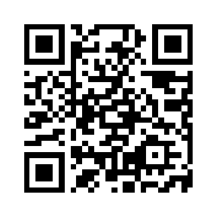
MacDuff
Pivotal Moments
Purpose
Stretch Your Vocab
Word
Synonyms
Use in a sentence
gulpfiction.co.uk

Slide 21
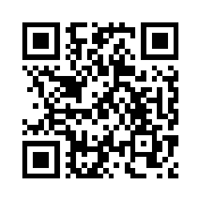
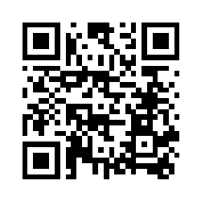
GF
"O horror, horror, horror, Tongue nor heart cannot conceive nor name thee! Confusion now hath made his masterpiece; most sacrilegious murder”
Scan me
"All my pretty ones? Did you say all? ”
Scan me
gulpfiction.co.uk

Slide 22
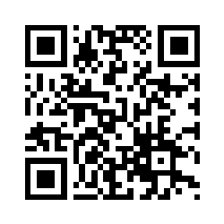
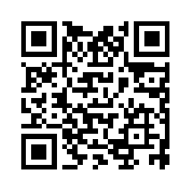
GF
"Tyrant, show thy face! If thou beest slain, and with no stroke of mine, my wife and children’s ghosts will haunt me still"
Scan me
“Despair thy charm,
And let the angel whom thou still hast served
Tell thee, Macduff was from his mother’s womb
Untimely ripped”
Scan me
gulpfiction.co.uk

Slide 23
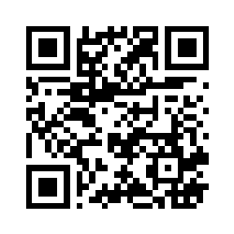
King Duncan
Pivotal Moments
Purpose
Stretch Your Vocab
Word
Synonyms
Use in a sentence
gulpfiction.co.uk

Slide 24
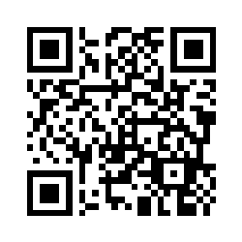
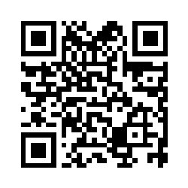
GF
“O valiant cousin! worthy gentleman!”
Scan me
“There's no art
To find the mind's construction in the face:
He was a gentleman on whom I built
An absolute trust”
Scan me
gulpfiction.co.uk

Slide 25
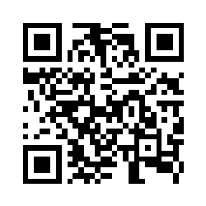
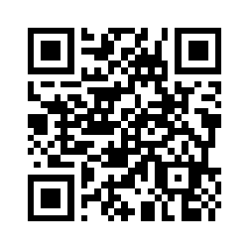
GF
“This castle hath a pleasant seat; the air
Nimbly and sweetly recommends itself
Unto our gentle senses”
Scan me
"Here lay Duncan,
His silver skin laced with his golden blood;
And his gashed stabs looked like a breach in nature”
Scan me
gulpfiction.co.uk

